Slide 1





Discovering Sleep Patterns with Lifestyle Modeling and Predictive Analytics
Team# 02:
Suleman khan_(02423029)_Online Affiliation KIST Seoul
Adnan Mumtaz_(02421070)_ Online Affiliation KITECH
M. Farooq_(02323027)_ Online Affiliation KIMM
Professor’s
Eunhui Kim Affiliation KISTI Daejeon
Insung Ahn Affiliation KISTI Daejeon
Jeong Yuna Affiliation KISTI Daejeon

Slide 2
Contents
Introduction
Data Analysis
Hypothesis Testing
Modelling
Summary of Model Performance
Conclusion
Acknowledgment

Slide 3

Introduction
Importance of Sleep Quality:
Sleep is fundamental for mental well-being and physical performance.
Nowadays our sleep is largely impacted by modern lifestyle habits.
Screen Time as a Sleep Disruptor:
Pre-bed screen exposure delays melatonin release.
Screens disrupt the sleep-wake cycle and reduce sleep quality ( Carter et al., 2016).
Role of Predictive Models:
Machine learning models analyze sleep patterns using lifestyle and health data.
Gregorius Airlangga (2024) applied ML to predict sleep disorders.
Models provide valuable insights but need refinement for real-time, actionable solutions.
Study Goal:
Investigate lifestyle habits (screen time, sleep disturbances) affecting sleep quality.
Use data-driven approaches to bridge gaps in existing research.

Slide 4


Data collection
Publicly Available Datasets:
Identified & collected datasets of sleep affecting lifestyle factors.
The datasets provided baseline information on these key variables:
Sleep duration
Exercise frequency
Screen time
Customized Survey Datasets:
This survey implemented data with self-reported information
The key data points captured during this survey were:
Sleep quality and duration
Screen time duration especially before sleep
Exercise habits e.g. intensity and frequency
Additional variables like age, gender and daily routines.

Slide 5


Pre-processing
Handling Missing Data:
Reviewed survey responses for missing or incomplete entries.
Applied imputation techniques to fill missing data.
Outlier Management:
Outliers handled using statistical methods to ensure data integrity.
Data Merging and Formatting:
Combined public data with survey responses into a united dataset.
Ensured alignment of:
Measurement units
Variable definitions
Categorize data in low, moderate & high levels.
Data consistency

Slide 6
Introduction
Data Analysis
Hypothesis Testing
Modelling
Summary of Model Performance
Conclusion
Acknowledgment

Slide 7
Data Analysis
Table 1 Summary Statistics of Key Variables
 | Height (cm) | Weight (kg) | Sleep Quality | Stress Level | Heart Rate | Daily Steps | BMI | Night Sleep Dur
Count | 282 | 282 | 282 | 282 | 282 | 282 | 282 | 282
mean | 165.7 | 67.93 | 6.59 | 5.43 | 69.70 | 6774.70 | 24.64 | 7.24
std | 7.54 | 12.29 | 1.81 | 1.71 | 3.14 | 1589.13 | 4.60 | 1.51
max | 185.0 | 100.00 | 9.00 | 8.00 | 78.0 | 10000 | 36.5 | 10.67
min | 150.0 | 43.00 | 3.00 | 3.00 | 65.0 | 3000 | 13.90 | 3.50
Survey Results Summary
Sleep Quality:
Rating: 6/10 (moderate quality).
Body Mass Index (BMI):
Average BMI: 24.85.
Range: 13.9 to 41.3.
Night Sleep Duration:
Average duration: 8 hours.
Range: 3.5 to 10.67 hours.

Slide 8
Data Analysis
Majority of participants reported a sleep duration of 6+ hrs, aligning with recommendation.
These findings suggest participants have adequate sleep quantity but moderate quality.
Table 2 Summary Statistics of Sleep Study Participants
 | Age Group | Gender | Occupation | Exercise Days/Week | Device Usage (hrs/day)
count | 482 | 482 | 482 | 482 | 482
unique | 6 | 3 | 17 | 4 | 4
top | 35-44 | Male | Nurse | 1-2 Days | 4-6
freq | 189 | 256 | 73 | 206 | 190
 | Screen Time Before Sleep | Bedtime | Wake-up Time | Sleep Onset time | Nap Duration
count | 482 | 482 | 482 | 482 | 482
unique | 5 | 18 | 20 | 4 | 5
top | 30-60 min | 23:00 | 07:00 | 15-30 min | No nap
freq | 203 | 47 | 35 | 236 | 129
 | Sleep Disturbances | Sleep Medication | Language | Blood pressure | Sleep duration
count | 482 | 482 | 482 | 482 | 482
unique | 5 | 2 | 6 | 25 | 3
top | Rarely | No | Urdu | 130/85 | 6+ h
freq | 61 | 64 | 48 | 48 | 68

Slide 9
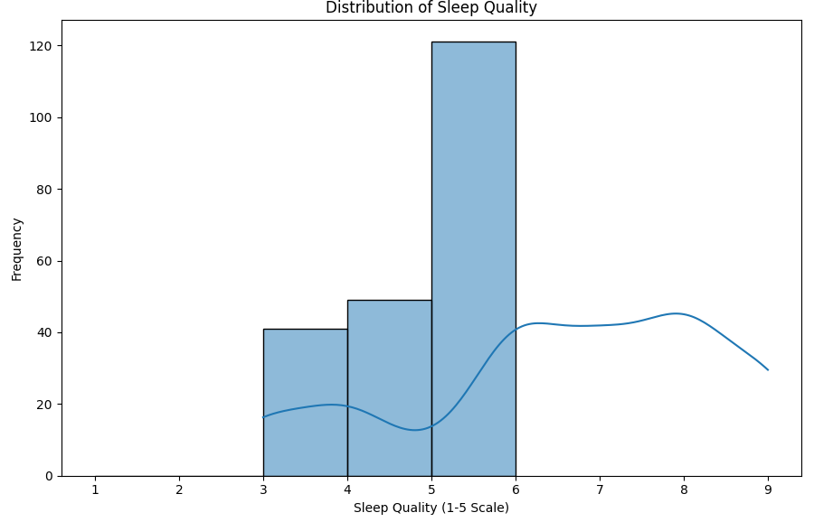
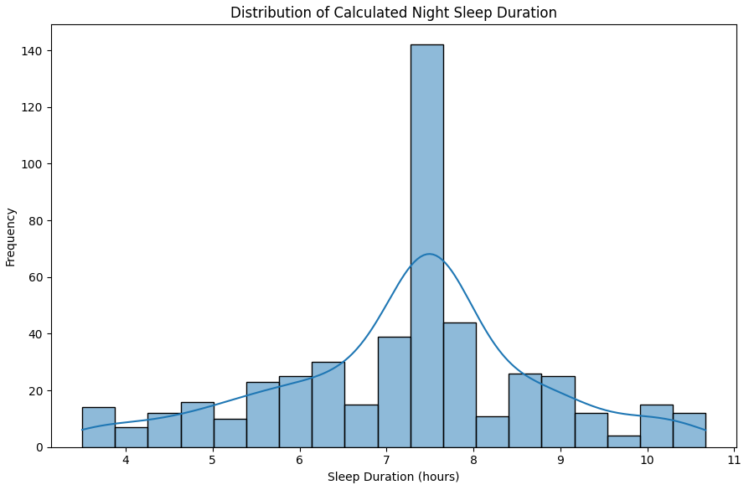
Data Analysis
Sleep Quality and Duration Distribution:
Sleep quality scores concentrated between 3 and 6, with a peak at 6 (moderate quality).
Sleep duration follows a normal distribution centered around 7.5 hours.
Fewer cases of extreme short (<5 hours) or long (>9 hours) sleep durations.

Slide 10
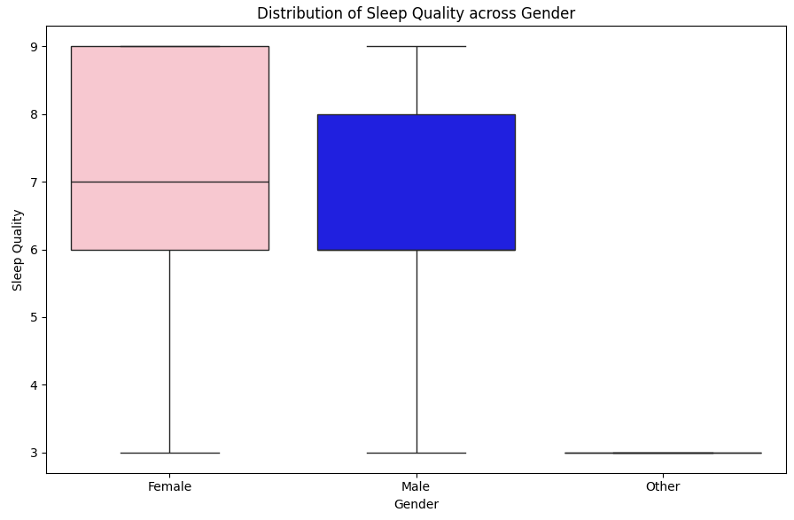
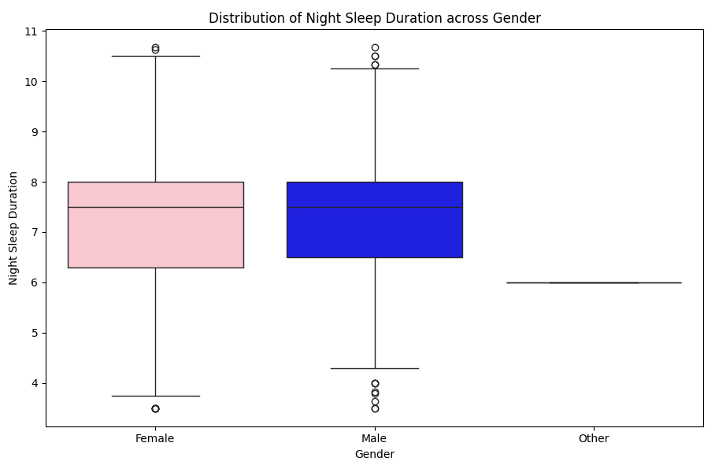
Data Analysis
Boxplot Analysis Findings:
Female participants show higher median sleep quality, also slightly longer sleep duration.
Male participants display lower median sleep quality and shorter sleep duration.
The “Other” category is indicating insufficient data that could not give meaningful result.

Slide 11
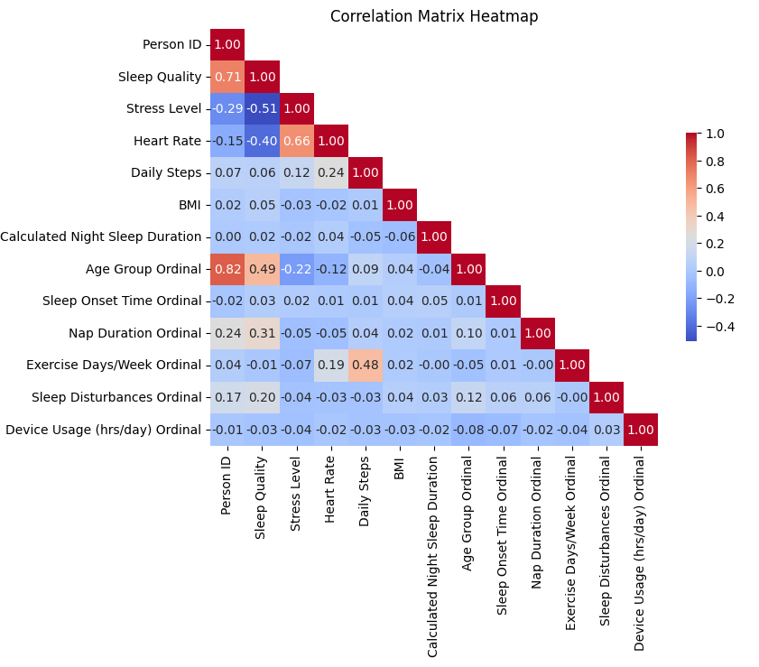
Data Analysis
Correlation matrix heatmap:
Sleep quality show strong negative correlation with stress, → higher stress= lower sleep quality.
Moderate positive correlation b/w age and sleep quality mean older people have better sleep.
BMI demonstrate weak correlation with sleep quality.

Slide 12
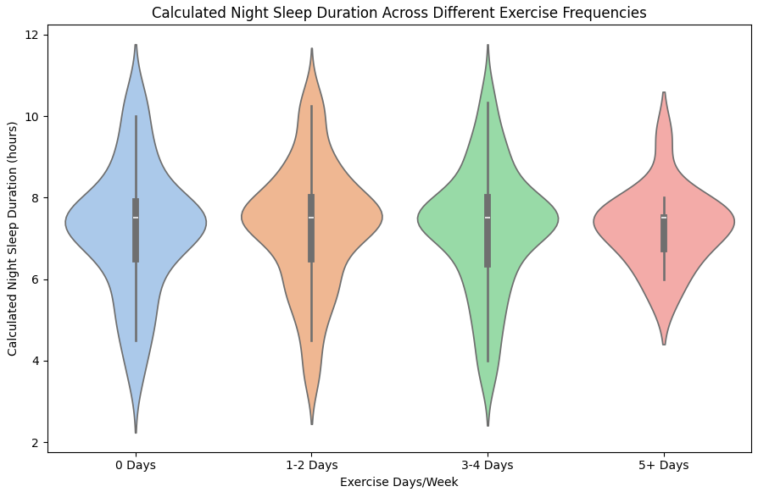
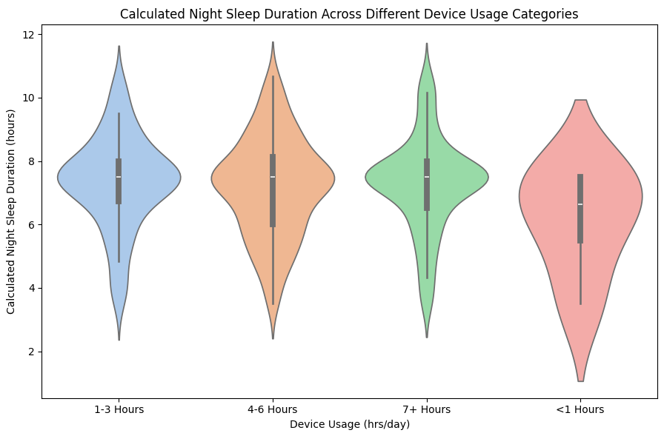
Data Analysis
Exercise and device usage impact on sleep quality:
Higher exercise frequencies (3-4 days) are associated with longer sleep duration.
Higher device usage (4-6 hours, 7+ hours) is associated with shorter sleep durations.
Increased screen time which may lead to shorter sleep due to:
Higher physical fatigue, blue light exposure and stress.

Slide 13
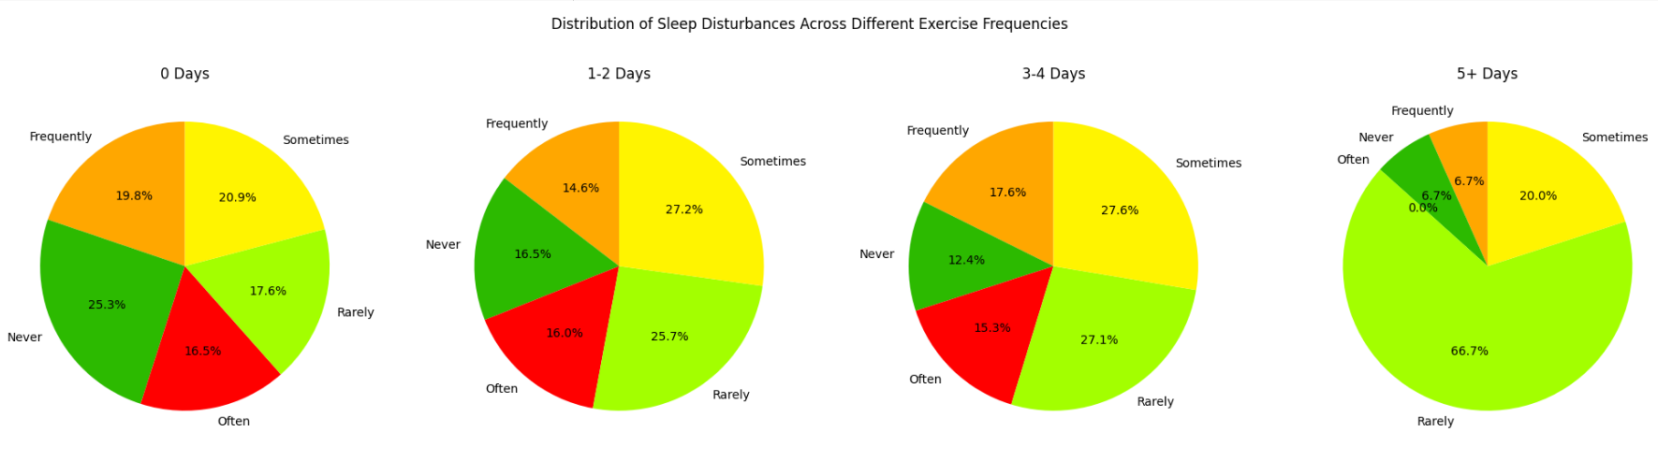
Data Analysis
Sleep disturbances trend across exercise frequencies:
Rarely is near most common response at different exercise frequencies.
It shows regular exercise is associated with fewer sleep disturbances.

Slide 14
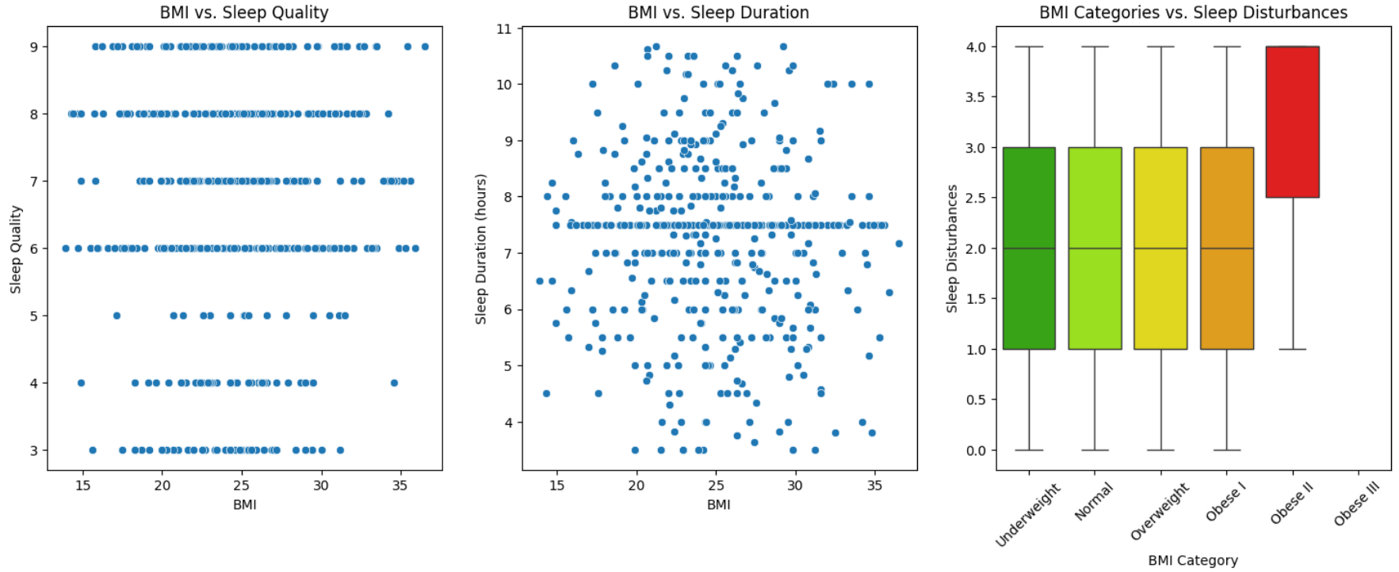
Data Analysis
Scatter plots show no clear correlation between BMI and sleep quality or duration.
Box plot reveals higher sleep disturbances in the “Obese III” category.

Slide 15
Introduction
Data Analysis
Hypothesis Testing
Modelling
Summary of Model Performance
Conclusion
Acknowledgment

Slide 16
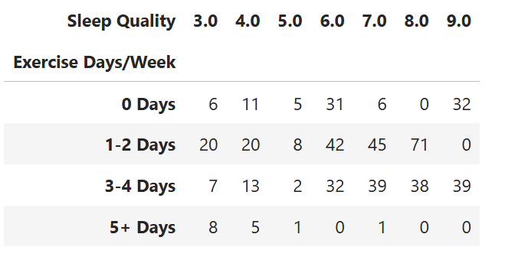
Hypothesis Testing
Hypothesis 1: Increased sleep disturbances negatively impact sleep quality.
Null hypothesis: There is no significant relation between sleep disturbances and sleep quality.
Alternative hypothesis: There is significant relation b/w sleep disturbances and sleep quality.
Chi-squared statistics is 86.14 with p-value of 6.21e-09 which is quite low.
Hence null hypothesis is rejected so there is relationship between disturbance to quality.
Table 3 Contingency table sleep disturbances and sleep quality

Slide 17
Hypothesis Testing
Hypothesis 2: The longer it takes to fall asleep, the worse sleep quality becomes.
Null hypothesis: The increase in sleep onset time has no impact on sleep quality.
The spearman correlation coefficient is 0.034, a very weak positive correlation.
This suggests longer times to fall asleep are slightly associated with high sleep quality.
The p-value of 0.772≥0.05, shows that the correlation is not statistically significant.
The null hypothesis cannot be rejected.
Additionally, chi-squared test shows a p-value of 0.0270. Although relation exists between sleep quality and sleep onset time but it is moderate relation, not much strong.

Slide 18
Introduction
Data Analysis
Hypothesis Testing
Modelling
Summary of Model Performance
Conclusion
Acknowledgment

Slide 19
Modelling
Predicting night sleep duration:
The linear regression model performed best with MSE of 2.34 and R² score= -0.064.
Decision tree regressor performed poorly with MSE of 3.75 and R² score= -0.70.
Table 4 Night sleep duration prediction using different models
Model | Mean Squared Error | R² Score
Linear Regression | 2.34 | -0.064
Decision Tree Regressor | 3.75 | -0.70
K-Nearest Neighbours | 2.77 | -0.25
Support Vector Machine | 2.31 | -0.053

Slide 20
Modelling
Predicting sleep quality:
Random forest emerged as the most accurate model.
Multiclass logistic regression exhibited lowest accuracy with low F-1 score.
Table 5 Night quality prediction using different models
Model | Accuracy | Weighted Avg F1-Score
Multiclass Logistic Regression | 0.21 | 0.16
Decision Tree Classifier | 0.60 | 0.61
Random Forest | 0.63 | 0.63
K-Nearest Neighbors | 0.47 | 0.48
SVM | 0.23 | 0.16

Slide 21
Introduction
Data Analysis
Hypothesis Testing
Modelling
Summary of Model Performance
Conclusion
Acknowledgment

Slide 22
Summary of Model Performance
Linear Regression demonstrated the lowest error but still fell short with a negative R2 score, indicating limited suitability for predicting night sleep duration.
For classification, Random Forest outperformed other models with the highest accuracy.

Slide 23
Introduction
Data Analysis
Hypothesis Testing
Modelling
Summary of Model Performance
Conclusion
Acknowledgment

Slide 24
Conclusion
Key Finding of the Study:
A strong negative correlation between stress levels and sleep quality, indicating that higher stress is linked to poorer sleep.
A moderate positive correlation between age and sleep quality, suggesting older participants tend to report better sleep.
A moderate positive correlation between exercise frequency and daily steps, highlighting that individuals who exercise more tend to be more active.
Minimal impact of exercise frequency or device usage on sleep quality, with scores generally clustered between 6 and 8 across all categories,
Lower exercise frequencies and higher device usage appear to be linked to shorter sleep duration.
Those with no exercise habits reported more sleep disturbances.
Findings suggest further optimization is required to enhance predictive power of models.
Improvements could be data balancing and hyper parameter tuning.

Slide 25
Introduction
Data Analysis
Hypothesis Testing
Modelling
Summary of Model Performance
Conclusion
Acknowledgment

Slide 26
Acknowledgment
We extend our heartfelt gratitude to everyone who contributed to the success of this project.
Special thanks are due to our professors and teaching assistant at KISTI e.g. Prof Eunhui Kim, Insung Ahn & Jeong Yuna.
Thanks to our team members for putting efforts in this project.
Member | ID No | Role
Suleman Khan | 02423029 | Data preparation, cleaning, analysis, modelling, Proposal Presentation
Muhammad Farooq | 02323027 | Visualization, evaluations, final report writing
Adnan Mumtaz | 02421070 | Hypothesis testing, presentation preparation and final presentation
GitHub Link of everything: (Dataset, Code, initial Presentations, Final Report & Final Presentation)
https://github.com/khansuleman12/Sleep-Synth-with-LifeStyle-Modeling_-BIG-DATA

Slide 27
Thank you ☺

